Slide 1



Cloud Native Architecture 300
Notes:
In this presentation we’re going to cover cloud native architecture

Slide 2
Cloud Native Architecture
Why
What
How
Notes:
The way we build software is changing. We'll talk about why it's changing, what is different about the software we're building now, and how we can go about achieving this new style of software design.

Slide 3
Cloud Native Architecture
Why
What
How
Cloud Computing
New Demands
Being Reactive
Notes:
More specifically in terms of why, we’ll talk about cloud computing and how cloud computing has created new demands and expectations

Slide 4
Cloud Native Architecture
Why
What
How
Cloud Computing
New Demands
Being Reactive
Reactive Design
12 Factor Apps
Microservices
Design Patterns
Notes:
We’ll cover some of the new principles and methodologies for building software, including 12 factor apps and microservices.

Slide 5
Cloud Native Architecture
Why
What
How
Cloud Computing
New Demands
Being Reactive
Reactive Design
12 Factor Apps
Microservices
Design Patterns
Tools
Platform
Process and Culture
Notes:
Finally we’ll talk about some of the tools we can use to implement cloud-native architecture, and some organizational aspects to keep in mind

Slide 6
Cloud Native Architecture
Why
What
How
Cloud Computing
New Demands
Being Reactive
Notes:
Let’s start with why. What is cloud computing and what are some of the new demands that were facing? What does it mean to be reactive to these demands?

Slide 7
Cloud Defined
Cloud Computing
Cloud Native Applications
Cloud Native Application Architecture
Notes:
Cloud computing is a model of computing where resources are provided over the network in an on-demand manner, often ephemeral, and independent of any specific physical manifestation.
We’re essentially talking about highly distributed systems.
Cloud native applications are applications that are built on the assumption that they’re going to be deployed to a cloud-based operating environment.
Cloud native architecture refers to patterns that we identify that work well for cloud native applications.

Slide 8
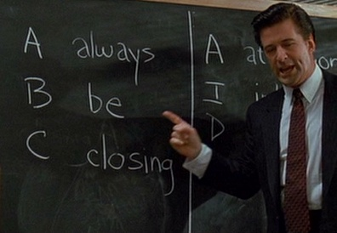
Cloud-Era Demands
Competitive landscape
Consumer expectations
Device Diversity & Ubiquity
Scale
D
delivering
Notes:
Having all of this distributed compute power readily available and easily accessible has led to new demands.
For one thing, it has changed the competitive landscape. It has enabled incredible innovation. Small, software-based businesses are constantly introducing new or improved services. They can quickly respond to consumer feedback and behavior, and they are eating market share that has for a long time remained by and large stable and well within the jurisdiction of larger, established enterprises.
Consumer expectations have skyrocketed. The cost of switching from one provider to another is very low, so the ability to deliver innovative, high value, high quality products, incorporate user feedback quickly, and deliver quality service consistently are critical.
We see an incredible diversity in the types of devices that we have to service, whereas before we only needed to account for desktops or laptops and then eventually smart phones and different sorts of tablets, now we have to consider that any “thing” could be a client – televisions, medical equipment, household appliances, wearables, all kinds of sensors - and that diversity and ubiquity is only going to grow.
Even with just phones and tablets, the scale we need to accommodate with zero downtime is huge, and that, too, will only continue to grow. Not only do we have an increasing number of devices, but the frequency of requests from any given device is also growing.

Slide 9
Being Reactive
React to Events
React to Load
React to Failure
React to Users
http://www.reactivemanifesto.org
Notes:
We need to build systems and software that will enable us to react to these demands.
We’ll go into what that means in a minute, but for now I’ll just mention a quote from an old New York Times article about Steve Jobs that said
“you can’t engineer innovation, but you can increase the odds of it occurring.”
If we have systems that will enable us to react to events and load and failure and users, then we can meet the demands of this new cloud world.
-----
“you can’t engineer innovation, but you can increase the odds of it occurring”
NY Times, “Reaping the Rewards of Risk-Taking,” Steve Lohr, Aug 27, 2011
http://www.nytimes.com/2011/08/28/technology/steve-jobs-and-the-rewards-of-risk-taking.html?pagewanted=all

Slide 10
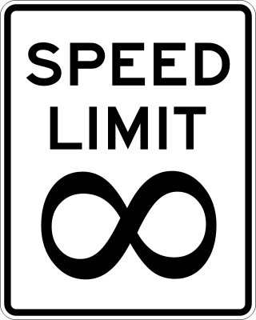
Speed & Safety
Design for quick recovery
Quick recovery increases risk tolerance
Risk tolerance enables innovation
Notes:
Let’s take a moment to think about the relationship between speed and safety. Think about what would empower you to be able to drive a car fast. If you trust the wheel and the brakes to respond when you need them, you can go faster, maybe take sharper turns or explore new terrain.
If we have a system that is reactive to load to failure, a system that is tolerant to risk, then we will be able to move more quickly. Will be able to get new ideas to market faster and more often. And that same speed will empower us to take more business risks, because as quickly as we put a new idea out there, we can very quickly replace it with something better based on user feedback. This combination of speed and safety are going to help us deliver better product.
The truth is we can no longer afford to move slowly. We can’t take six months or a year to get a product out to market only to discover that someone else beat us there or the idea doesn’t work as well as we thought and then take another six months or a year to try something different. We don’t have the luxury of waiting.

Slide 11
Cloud Native Architecture
Why
What
How
Reactive Design
12 Factor Apps
Microservices
Design Patterns
Notes:
Let’s move on to what cloud native applications are. We’ll talk about 12 factor apps, microservices, and some of the design patterns for cloud native architecture.

Slide 12
Reactive Design
React to Events → Event-Driven
React to Load → Scalable
React to Failure → Resilient
React to Users → Responsive
http://www.reactivemanifesto.org
Notes:
Going back to the idea of being able to react to new demands, from a system design perspective, we need a system that is:
Event-Driven, so that we can respond to events
Scalable or elastic, so that we can respond to load
Resilient, so we can react to failure, and
Responsive, so we can respond to users quickly, whether its end users or other systems using our APIs

Slide 13
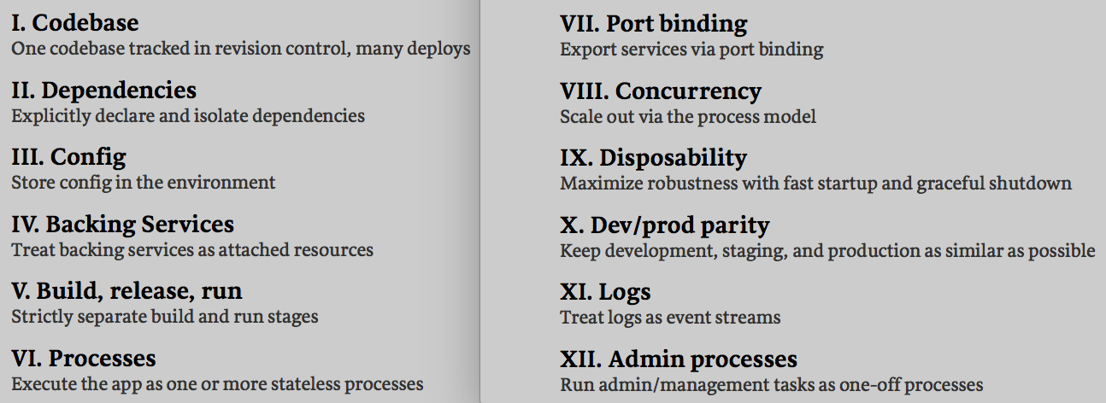
The Twelve Factor App
http://12factor.net
Notes:
12 factor app is a methodology that tells us HOW to build software in a way that takes advantage of modern cloud platforms. It defines a clean contract with the underlying cloud platform.
By adhering to this contract, we define a clean separation of responsibility between the app and the underlying system. We decouple the app from system concerns, which simplifies our apps and gives us greater portability across execution environments, greater consistency between development and production, greater agility and scalability, and the capability for continuous deployment.

Slide 14
The Twelve Factor App
http://12factor.net
Notes:
Just to highlight a few, the first one says that every app should have a separate codebase, a separate code repository. If you have one application that is composed of several repositories, then what you have is a distributed system, not a 12 factor app. Each of those code repos composing your distributed system could be 12 factor, but the larger application is a distributed system, not an app. On the flip side, if you have multiple apps sharing a codebase, that’s also a violation of 12 factor. You could have libraries that are used by different apps but at the codebase level you should be able to take that app and deploy it independently all the way through production without impacting any other app codebase. This is a way to encourage loose coupling that sets us up for the ability to do continuous deployment.

Slide 15
The Twelve Factor App
http://12factor.net
Notes:
In terms of dependencies, a 12 factor app decouples the choice of programming framework from the underling platform. If your app explicitly declares all of its dependencies rather than relying on the system to provide language-specific libraries or packages, then you can write your app in any language of your choice. Every app needs to explicitly declare all of its dependencies, aiming to be self-contained, self-sufficient and complete in its definition as a unit of deployable, runnable work. A clean separation of concerns between app and underlying platform that gives us greater choice and portability.

Slide 16
The Twelve Factor App
http://12factor.net
Notes:
Another pillar of 12 factor apps is strict separation between the code base and any configuration that needs to change cross deployments. Moreover, configuration should be made available through mechanisms that are agnostic to the programming framework, a good example being environment variables or a centralized config repository accessible to all kinds of apps.

Slide 17
The Twelve Factor App
http://12factor.net
Notes:
There’s also a contract for loose coupling between the app and any kind of backing service that it uses, whether the backing service is a local database or queue, or a third-party resource like Amazon S3, New Relic, or Google Maps, they’re all treated in the same loosely coupled way as attached resources, decoupled from the code. This gives the administrator of the backing service the ability to detach and attach a service instance without requiring any code changes.

Slide 18
The Twelve Factor App
http://12factor.net
Notes:
12 factor also warns us not to rely on local memory or disk for persistence. In a horizontally scaled platform, we assume failure will happen, so we have to allow the underlying cloud platform to replace processes in case of failure. Any state that needs to be persisted should be stored in a backing service so that we can keep our apps stateless.

Slide 19
The Twelve Factor App
http://12factor.net
Notes:
12 Factor also tells us to treat logs as event streams. The app is responsible for emitting logging information, but it should not concern itself with the managing, storing, or routing log files. That is a system concerns and the responsibility of the execution environment.
This approach also ensures apps are not using local disk to store log files, which as we just saw in the last factor, would make our app instance stateful and violate 12 factor.
What’s great is that with logs provided as event streams, we don’t have to ssh all over the place to collect our logs anymore. Instead, our logs are streamed to us over the network. Makes troubleshooting much easier.
Overall, besides providing guidance on how to write individual apps, 12 factor informs us about what we need from the underlying platform and what we might want from development tools. We’ll touch on those points again later in this presentation.
-----
Auxiliary notes:
Add a slide on Port Binding? network is assumed…

Slide 20
Microservices
If services have to be updated together,
they’re not loosely coupled!
Loosely coupled service oriented architecture with bounded contexts
- Adrian Cockcroft
If you have to know about surrounding services,
you don’t have a bounded context
Notes:
So now we know HOW to build an individual app that will take advantage of a cloud environment.
Let’s look at the bigger picture of composing a distributed system of apps. This is motivation behind microservice, or cloud-native architecture.
The concept of a microservice builds on the idea of a 12-factor app. If we stick to 12 factor, then each microservice will run as a discrete and isolated unit of work. It is discrete in the sense that it focuses on a small set of responsibilities (think back to 12 factors guiding us to have one codebase per app), and isolated because it is a self-sufficient runnable artifact, an inherently distributed entity (remember 12 factor helps us write apps that are decoupled from the execution environment with explicitly declared dependencies, externalized configuration, attached backing services, etc).
One way to evaluate our microservices is to ask:
Can I update each service without having to update other services, and
Can each service fulfill its responsibility without relying on surrounding services
If we can answer yes to both of those questions, then we have well-defined microservices with loose coupling and bounded contexts.
-----------------------
Auxiliary notes on defining the bounded context:
Model services from the domain
Domain driven design
Services implement a contract
Services use models matching their local view of the domain
Where models diverge is a good clue to a boundary
This is where domain knowledge has the biggest impact
Spend your resources here

Slide 21
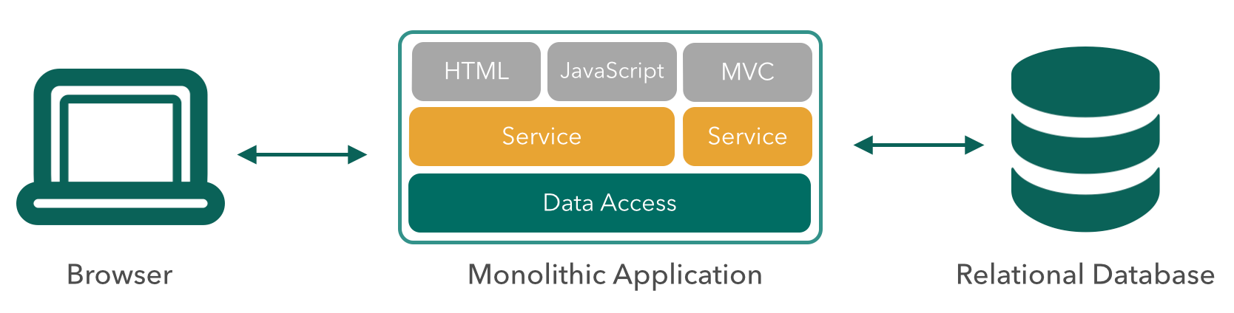
Not Monoliths
Notes:
We’re moving away from monolithic software and towards a distributed system of services.
Just to clarify, when we talk about monoliths, there’s a continuum between monoliths and service oriented architecture and microservice architecture and most enterprises are somewhere along the continuum. Very old software tends to be truly monolithic where the code is a one codebase in its entirety very much intertwined and interdependent, but most enterprises that have made significant strides towards service oriented architecture and have achieved loose coupling at the logical level but often still deploy as monoliths, meaning they package of a bunch of services and deploy them as a single artifact, so they don’t have the ability to update a single service without redeploying other code or to scale a certain service independently of others. These deployed monoliths are also generally dependent on the target application container or execution environment for dependencies, so they’re not inherently distributed entities that align well to a cloud environment. All of the things together mean that continuous deployment, failure isolation, and a clean contract with the cloud execution environment are still out of reach.
This doesn’t mean that there’s no place for a monolith. Monoliths are still often easier to code, so they’re very useful for initial brainstorming of ideas. However, as an application matures and grows, if new functionality continues to be added to a monolith we will eventually lose transparency and visibility into how that monolith works and what the interdependencies are. On the other hand if, as the system grows, we mature into a microservice model, the fact that microservices are composed of discrete units of work communicating over the network will make the system more transparent and understandable and, in the long-term, more resilient, flexible and manageable.

Slide 22
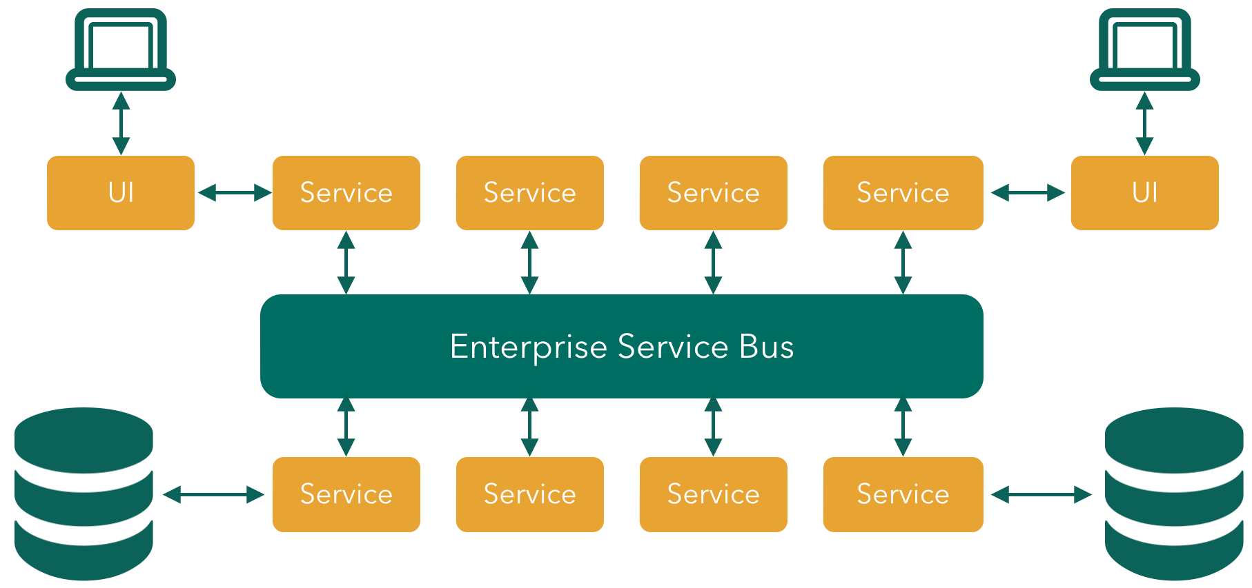
Not ESB-Centric SOA
Notes:
We’re also moving away from ESB-centric architecture.
ESB’s don’t work well in a cloud environment. There’s a lot of configuration that’s built into them which again, going back to 12 factors, is something we want to avoid. ESB’s also encourage canonical data models that are rigorous and require a lot of up-front cross-functional decision-making. Change, such as adding a new field to a data structure, is often very disruptive with ESBs because it impacts many integration flows. They are also essentially silos, often requiring significant technical expertise to configure and manage, and we want to move toward independent teams creating services that can be deployed freely and the clean contract we saw with 12 factor between our applications and the execution environment.
-------------------------------------
Read more:
http://insights.wired.com/profiles/blogs/why-buses-don-t-fly-in-the-cloud-thoughts-on-esbs#ixzz3y6y8eTFI

Slide 23
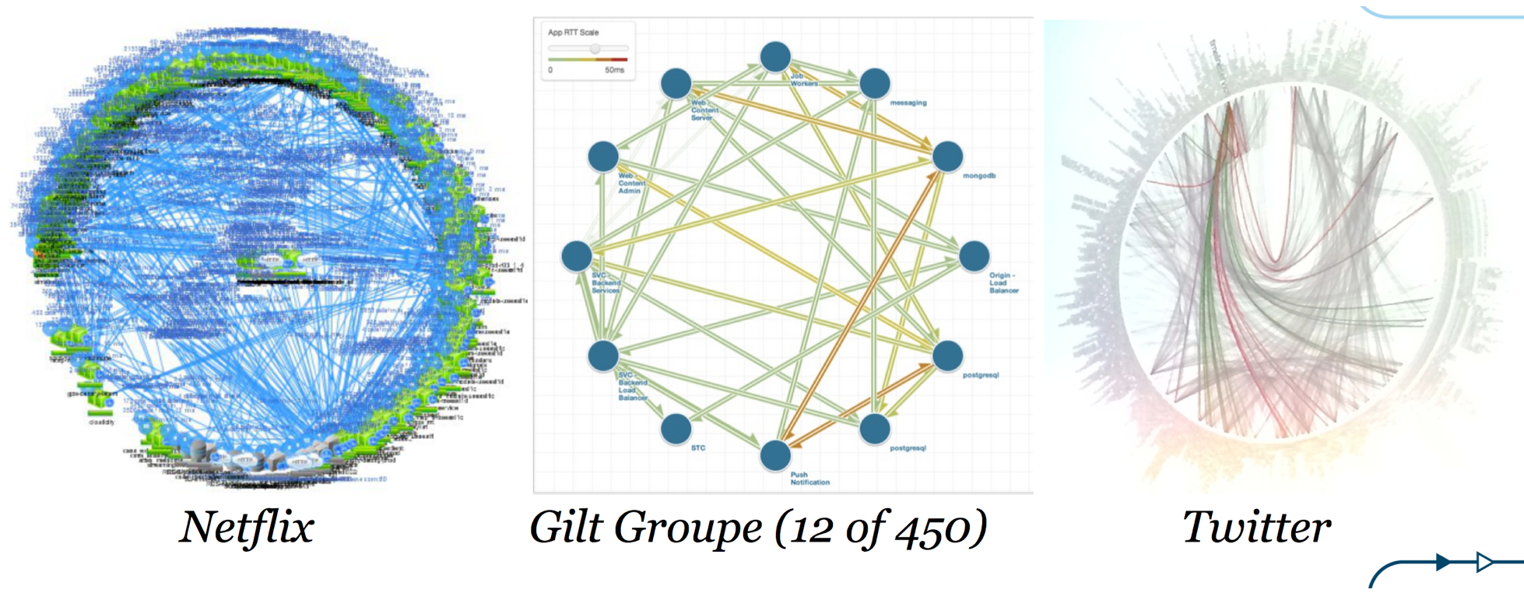
Microservice Pioneers
Notes:
So we know what were moving away from. What models can we look to as examples of something to emulate? Netflix, The Gilt Groupe, and Twitter are examples of some of the recognized leaders in pioneering micro service architecture successfully. Their proof positive of the kind of innovation the scalability and the resiliency that we can achieve using micro services and a more practical level we can learn from patterns that have enabled these companies to employ micro service architecture successfully and in some cases directly benefit from code that they have made available to the open source community. I’ll give a few examples later on the presentation.
So these images can be inspirational, but they also give us some insight into some new challenges we might face in managing highly distributed micro service architectures.

Slide 24
Who Moved My Complexity?
Microservices are individually simple
Complexity is transferred to the ecosystem
Notes:
So we’ve established that microservices are in and of themselves simple units of work. Discrete, isolated, scalable, decoupled from configuration and environment. They free us from system level concerns, allow us to leverage different development frameworks, organize in smaller teams, have a greater agility…
But simple doesn’t mean easy. Microservices need to interact with each other, and as our web of microservices grows, they can become difficult to operationalize. Whereas with monoliths the complexity was hidden inside of monolith, in the case of microservices, the complexity is transferred to the ecosystem. Designing microservice-based architecture, or cloud-native architecture, takes some thought, but with the right patterns and tools, we can address the challenges that arise.

Slide 25
Challenges in a Distributed System
Configuration management
Registration and discovery
Routing and load balancing
Fault tolerance and isolation
Aggregation and transformation
Monitoring and distributed tracing
Process management
Notes:
What are some of the challenges we face with distributed systems?
Let’s go through each of these and talk about a design pattern that we can apply to address each particular challenge.

Slide 26
Design Patterns & Automation to the Rescue!
Config
Server
Service
Registry
Circuit Breaker Dashboard
Tracing Dashboard
Client
UI
(JavaScript)
UI Server
Proxy
Edge
Service
Backend Service
Circuit Breaker
Load Balancing
Backend Service
Backend Service
Notes:
Let’s use this as a boiler plate architecture to focus on the challenges and possible solutions. In this case, if we trace the middle row of services from left to right, we have a set of applications that will call each other to fulfill a request from the client. The top row, inside of the dotted rectangle, shows a set of services, for configuration, registration, and a couple of dashboards, that are shared by the applications. On the bottom row we see that there are some additional services that are also being used by the applications.

Slide 27
Configuration Management
Config
Server
Service
Registry
Circuit Breaker Dashboard
Tracing Dashboard
Client
UI
(JavaScript)
UI Server
Proxy
Edge
Service
Backend Service
Circuit Breaker
Load Balancing
Backend Service
Backend Service
Notes:
We know from 12 factor that we want to extract configuration that will be different between dev, test, and prod, but where do we put it and how do we manage updates across a distributed web of applications?

Slide 28
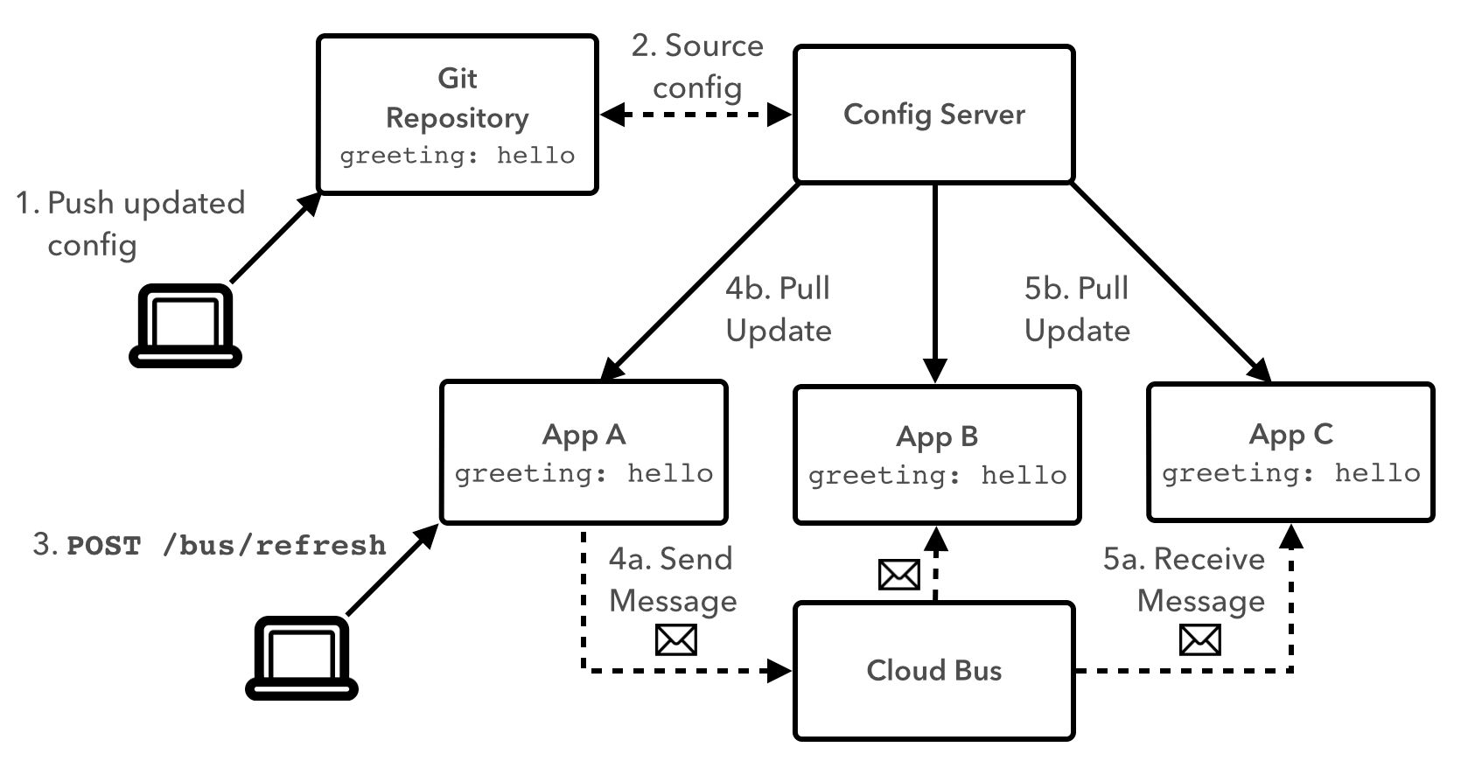
Configuration Server
Notes:
We can use a configuration server accessible to all applications to manage configuration.
Using a version control system, like git or subversion, as a backing for the config server provides additional benefits: we can maintain an auditable history of values over time, we can correlate the values the were used at any point in time, and we can direct different versions of the app to use different versions of configuration values.
Using a cloud bus allows us to propagate changes across the distributed system. We can use a REST endpoint to trigger an application to refresh its configuration, and that app would take care of publishing the change to the shared bus.

Slide 29
Registration and Discovery
Config
Server
Service
Registry
Circuit Breaker Dashboard
Tracing Dashboard
Client
UI
(JavaScript)
UI Server
Proxy
Edge
Service
Backend Service
Circuit Breaker
Load Balancing
Backend Service
Backend Service
Notes:
We know applications have to call each other to satisfy user requests but how can they find each other, and how can we achieve this in a way that works for applications written in an array of programming languages, and in an environment where app instances are treated as ephemeral?

Slide 30
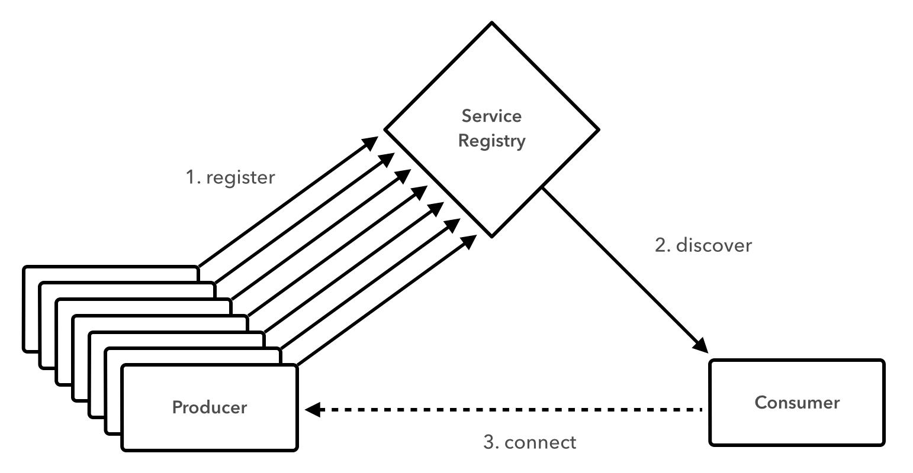
Registration and Discovery Server
Notes:
We can use a service registry so that instances of producer applications can register their endpoints, and consumer applications can obtain those endpoints. The concept is similar to UDDI, but UDDI implementations were coupled to WSDL and SOA stacks. A cloud-appropriate registry server doesn’t impose a particular spec on the producer or consumer, so it is more appropriate for polyglot environments.

Slide 31
Routing and Load Balancing
Config
Server
Service
Registry
Circuit Breaker Dashboard
Tracing Dashboard
Client
UI
(JavaScript)
UI Server
Proxy
Edge
Service
Backend Service
Circuit Breaker
Load Balancing
Backend Service
Backend Service
Notes:
How can we handle routing and load balancing in a highly distributed environment where app endpoints could be frequently changing?

Slide 32
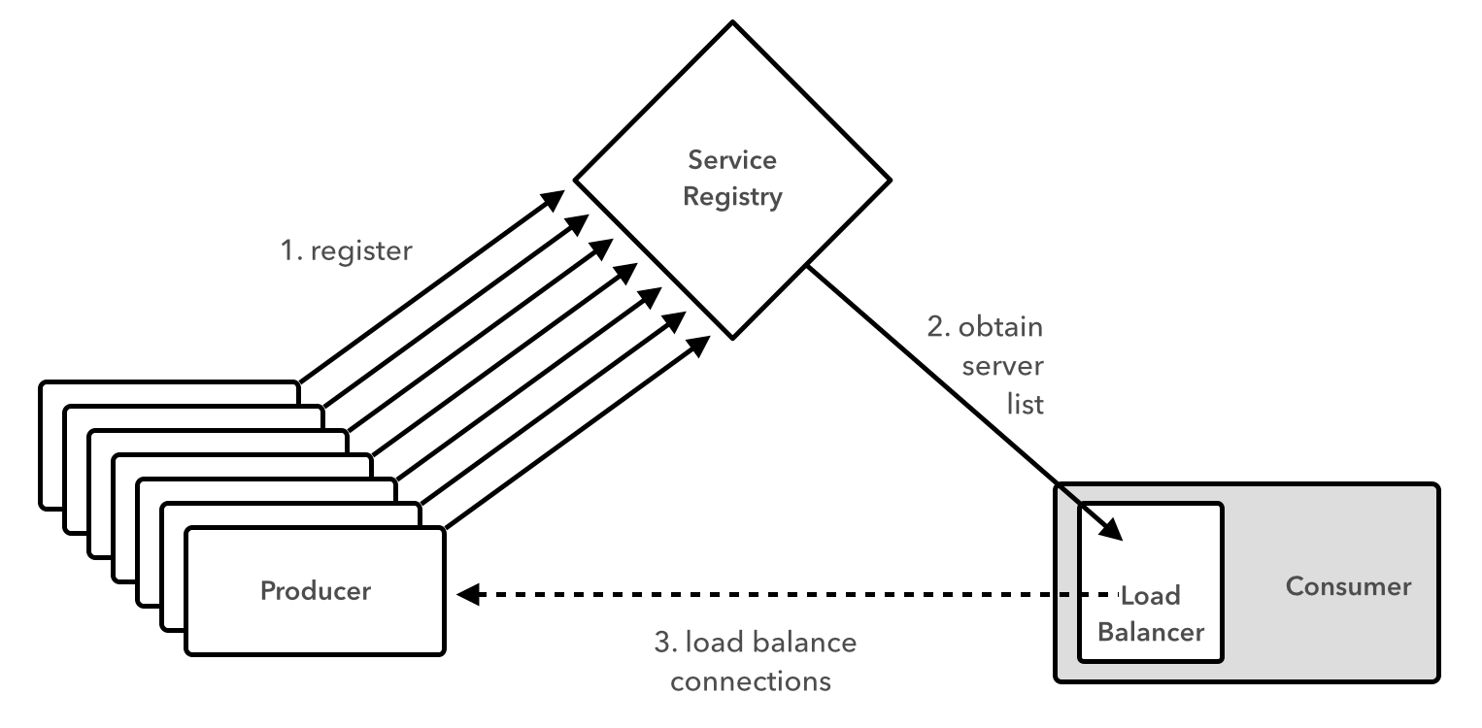
Client-Side Load Balancing
Notes:
We can move load balancing to the client. Here we see that a consumer application can obtain a full list of endpoints for a particular consumer from the registry, rather than hitting the registry every time it needs to call the producer. This way, the consumer can choose its preferred load balancing algorithm, whether it’s round robin, random, or weighted based on performance, and if it finds the endpoints become outdate, it can refresh the list from the registry. This model reduces hops to the registry or through a router.

Slide 33
Fault Tolerance and Isolation
Config
Server
Service
Registry
Circuit Breaker Dashboard
Tracing Dashboard
Client
UI
(JavaScript)
UI Server
Proxy
Edge
Service
Backend Service
Circuit Breaker
Load Balancing
Backend Service
Backend Service
Notes:
As we discussed earlier, one of our main motivators for moving towards cloud native architecture is to increase our chances of innovation. We need speed, and for speed we need safety. How do we achieve that risk tolerance? How do we isolate and adapt to failure?

Slide 34
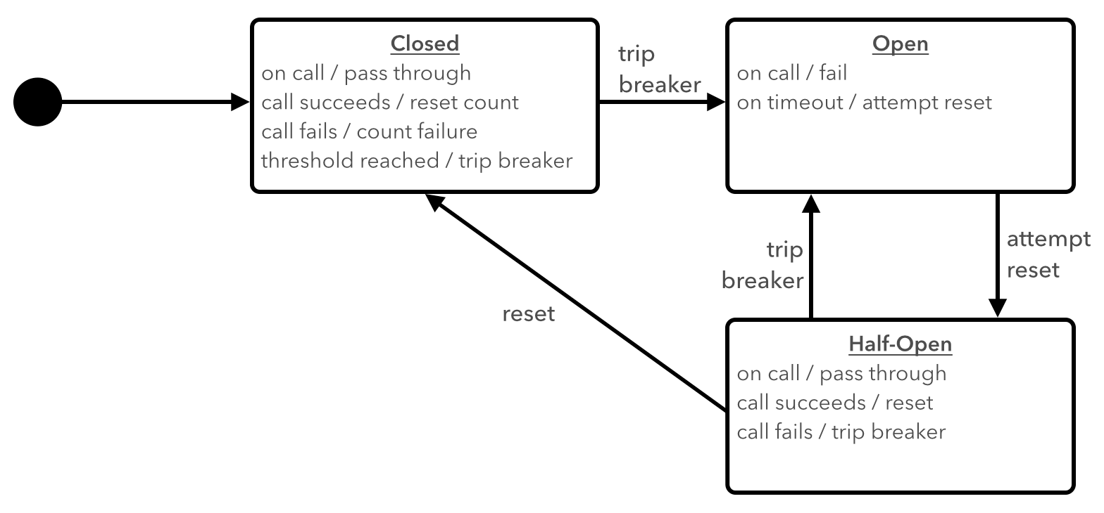
Circuit Breaker
Notes:
The circuit breaker pattern introduces the idea of a fallback action that can be taken when the “happy path” fails. Similar to an electric circuit breaker, the circuit breaker trips upon failure, or when a certain threshold of failure is exceeded. When the circuit breaker is open, the fallback action becomes the default path. The concept of a half-open state means that the happy path is periodically attempted, so that the system can automatically revert to the happy path as default when the cause of failure has been remediated.
We can add a circuit breaker dashboard to get a comprehensive view of the state of all breakers defined in the system.

Slide 35
Aggregation and Transformation
Config
Server
Service
Registry
Circuit Breaker Dashboard
Tracing Dashboard
Client
UI
(JavaScript)
UI Server
Proxy
Edge
Service
Backend Service
Circuit Breaker
Load Balancing
Backend Service
Backend Service
Notes:
We also talked about the increasing diversity of clients, not just smartphones and tablets, but televisions and new medical equipment and wearables. How do we tailor our responses without over complicating the system?

Slide 36
API Gateway
Edge App
For Desktop
Worker
Apps
Edge App
For Smart Phone
Worker
Apps
Worker
Apps
Edge App
for IOT Device
Edge App
for Client X
Notes:
We can use edge services to handle the aggregation and transformation needed for each client type. This way we can also be respectful of bandwidth and battery usage on clients and serve back a response that contains only the data each client needs with a minimum number of hops between our application and the client.

Slide 37
Monitoring and Distributed Tracing
Config
Server
Service
Registry
Circuit Breaker Dashboard
Tracing Dashboard
Client
UI
(JavaScript)
UI Server
Proxy
Edge
Service
Backend Service
Circuit Breaker
Load Balancing
Backend Service
Backend Service
Notes:
With 12 factor, we also talked about each application providing logging as an event stream. However, when a user request traverses a series of applications, how can we trace the life of that request across the log streams of a distributed set of independent applications?

Slide 38
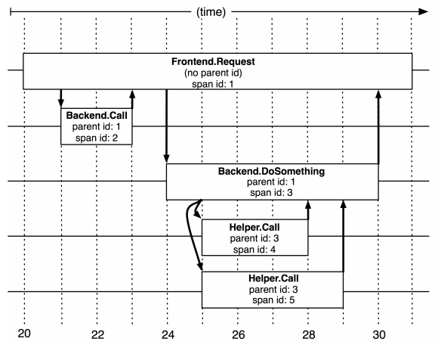
Distributed Tracing
Notes:
With distributed tracing, we assign a unique span id to every user request we receive. That id is passed to the next application that is called, as the parent id, so it can serve to correlate the transaction from the second application to the first. This pattern is followed throughout the life of the transaction, and if we think about a user request as a tre, where processing could follow multiple branches of applications, we can correlate the logging from any application back to the root of the tree using the parent and span ids.
To this we can add a dashboard to ad visualization to this distributed tracing.

Slide 39
Process Management
Tracing Dashboard
Config
Server
Service
Registry
Circuit Breaker Dashboard
Client
UI
(JavaScript)
UI Server
Proxy
Edge
Service
Backend Service
Circuit Breaker
Load Balancing
Backend Service
Backend Service
Notes:
How do we provision all of the necessary resources and ensure the system stays up? How do we fulfill all of the expectations that 12 factor apps imply about what the execution environment should provide?

Slide 40
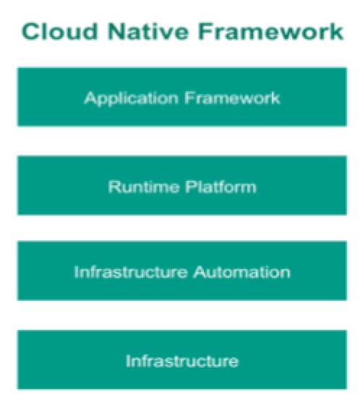
Structured Automation
Groundwork for devops
Self-service
Rapid, automated provisioning
Predictability and consistency
not ad-hoc!
Visibility (monitoring & metrics)
Continuous delivery on Day 2, too!
Notes:
With structured automation, we can ensure that the execution environment fulfills its end of the 12 factor contract. The platform should automate provisioning of resources, monitor the health of applications and replace them if they fail, aggregate the log streams from applications… By providing predictable and consistent automation, we can eliminate the workflows and handoffs between development and operations.

Slide 41
Cloud Native Architecture
Why
What
How
Tools
Platform
Process and Culture
Notes:
So we know why we want to go towards cloud native architecture, And we have an idea of what it means to be cloud native, let’s talk about how we get there. What development and automation tools can we leverage? And what do we want to keep in mind as we embark on a journey towards cloud native architecture?
Specifically, we’ll talk about

Slide 42
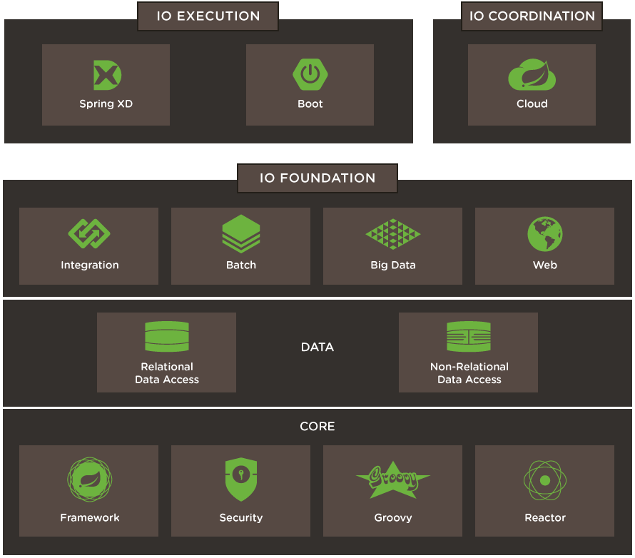
Spring I/O
Spring Boot
How you build an app
Spring Cloud
Pieces for Cloud Native
Spring Core
Notes:
Most Java developers are familiar with the widely adopted Spring Framework, which gives us inversion of control, dependency injection, and the facility to implement software with minimal code in adherence to best practice patterns across an array of use cases, batch, integration, etc…
Two new patterns have been added to the Spring Framework that are particularly relevant to cloud native architecture. Spring Boot and Spring Cloud.

Slide 43
Spring Boot
“Microframework”
Opinionated
Convention over configuration
Production ready
Ops Friendly
Self contained
Health and metrics
Externally configurable
Notes:
Spring Boot enables us to build 12-factor style apps with minimal effort. With a single annotation, we can define a production-quality runnable unit of work. It is self-contained and inverts the model of traditional middleware in that it contains the app server, Tomcat or Jetty, for example, within the app, rather than assuming the execution environment will provide it. Spring Boot also provides health and metrics to each app that are accessible via REST endpoints. As with the rest of the Spring Framework, it takes an opinionated apporach but can be configured as necessary.

Slide 44
Spring Cloud
Distributed/versioned configuration
Service registry and discovery
Routing
Service-to-service calls
Load balancing
Circuit Breakers
More…
Notes:
Spring Cloud contains implementations and integrations for a myriad of cloud native architecture patterns, and for interfacing with the underlying cloud execution environment.
Spring Cloud Connectors, for example, make it trivial to connect to services assuming the execution environment has provided the connection information through environment variables, in accordance with the 12 factor app contract.
With Spring Cloud Config, Spring Cloud Netflix, and Spring Cloud Consul, we can easily implement the configuration management, service discovery, circuit breaker, and client-side load balancing patterns we covered earlier and choose our preferred implementation from Spring Cloud, Netflix, or Hashicorp.
Spring Cloud Sleuth automatically implements distributed tracing, comaptible with Zipkin, Htrace, and ELK.
It includes additional projects and is continually expanding to cover a wider array of cloud use cases.

Slide 45







Spring Cloud Netflix Components
Ribbon
Archaius
Hystrix
Feign
Zuul
Client
Eureka
Turbine
Server
Notes:
Diving into Spring Cloud Netflix, for example, we see here some of the Netflix OSS projects for which Spring Cloud provides integrations.
Ribbon, the Netflix client-side load balancer, and Eureka, the Netflix discovery server, can be used together as we saw earlier where the client side load balancer loads routing information from the discovery server and applies its own load balancing rules.
Netflix Hystrix is an implementation of a circuit breaker. With Spring annotations, we can use AOP to add fallback commands to methods. We can also automatically report failures and metrics ass streams, in accordance with 12-factor app principles, and Netflix Turbine can collect these streams and provide an aggregated visualization into the state of all circuit breakers in the system.
------------------------------
Auxiliary notes:
Ribbon: A client load balancer. Ribbon loads routing info from Eureka. It has several implementations of load balancing rules. Ribbon is used internally by Feign
Feign: A declarative REST client. Allows annotation of interface to be mapped to endpoints. When combined with Ribbon it adds load balancing capabilities to the client interface
Hystrix: Circuit breaker patter implementation. Via spring annotations add commands to methods using AOP. Protects clients from failures and reports metrics via a stream of HTTP events
Zuul: A set of HTTP filters do add routing, security. On spring its used to create a CORS filter for UI apps to be able to access external services
Archaius: Dynamic configuration management. Used with Spring’s config server to allow dynamic properties loading
Eureka: Discovery server
Turbine: Event aggregation engine. It can combine several streams (hystrix) into one combined view, that can be view later on a dashboard

Slide 46
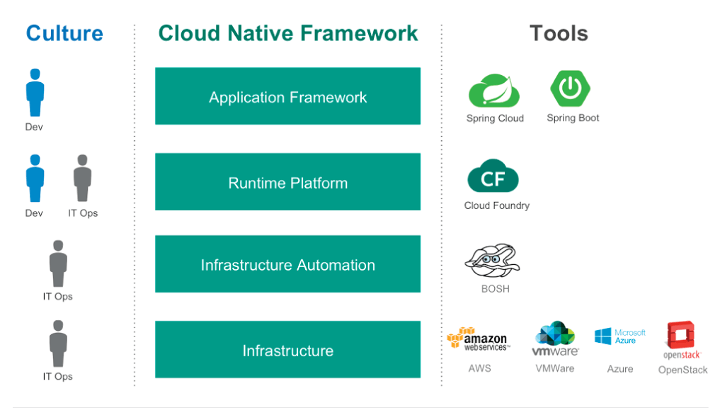
Pivotal Cloud Foundry
Notes:
Finally, we need an execution environment that fulfills the contractual requirements defined by 12 factor. We need consistent and predictable automation that separates concerns between infrastructure, runtime platform, and our application framework.
Pivotal Cloud Foundry, for example, provides rapid and automated provisioning of resources, from virtual machines, to middleware processes, to backing services and application instances. It provides application staging tailored to a number of development languages, as well as rapid application deployment for scaling and recovery. It also provides basic monitoring for visibility into application health and platform health, including log aggregation and automatic recovery of failed processes.
Pivotal Cloud Foundry also provides automation at the interface with the virtualized infrastructure such that the entire runtime platform is portable across IaaS providers. It provides self-service to developers and eliminates workflows between developers and operators, making devops possible.
Finally, Pivotal Cloud Foundry includes automatically provisioning of some of the resources needed to achieve the patterns we covered earlier, including, for example, Config Server, Eureka Discovery Server, and Hystrix Circuit Breaker Dashboard.

Slide 47
The Journey: Technology
Provide the right tools
Platform, design pattern foundations, continuous delivery…
Start small
Right-size for your needs
For migrations, don’t boil the ocean
Target applications that:
Have high business/competitive impact
Need to scale or change frequently
Notes:
What is the journey to cloud native look like?
To begin with, make the necessary tools available to your developers and operators. You need a cloud native platform, and you want to provide the necessary tools and training to enable your developers to implement the design patterns that will ensure long-term success.
Start small and focus on your actual needs. Don’t over-engineer solutions, try to keep things simple and right sized. Finally in terms of the applications to target for implementation on a cloudy platform, choose the ones that would benefit most from agility and innovation, That can add most value to your business, or those that need to scale or change frequently.

Slide 48

The Journey: Culture & Organization
Small, cross-functional teams
Products, not projects
Test-driven development
Short iterations
Transparency and visibility
Notes:
In terms of culture and organization, create small, cross functional teams that own products rather than projects. Teams that will own the products throughout their life cycle until they are retired from production. No more throwing things over the wall and hoping they don’t crack. With test driven development we set ourselves up for greater levels of automation and, hence, greater risk tolerance and continuous deployment. Test driven development also helps us approach our application design from the point of view of the user, and can be helpful in defining how we break down an application into individual microservices. With short iterations we can incorporate user feedback more quickly and more frequently, which is critical to innovation and meeting customer expectations. And finally maintain transparency and visibility at all levels.

Slide 49
Cloud Native Architecture
Why
What
How
Cloud Computing
New Demands
Being Reactive
Reactive Design
12 Factor Apps
Microservices
Design Patterns
Tools
Platform
Process and Culture
Notes:
In closing, we’ve covered the why, the what, and the how of cloud native architecture. If we want stay competitive and meet the demands of the modern era, we need to build cloud-native systems that are resilient and reactive to events, load, failure, and users. I hope this presentation has given you an idea of what that means, what tools and knowledge you need to arm yourself with to get there, and how to begin to approach that journey.

Slide 50
Thank You

Slide 51
Open.
Agile.
Cloud-Ready.

